Slide 1
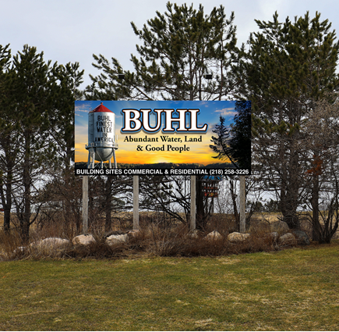
City of Buhl

Slide 2
Last significant growth occurred over 15 years ago. Prior to 2020, only 1 new home had been built since 2007. 2020-2025, the City expects at least 29 new homes to be built. 90% of homes in Buhl were built prior to 1960.
Buhl Housing History

Slide 3
Grant Funds, the City has partnered with the IRRR and SLC. Incentives to build. Partnerships, example Habitat for Humanity. Lot sizing. Smaller Developments that are manageable. Stubler 12 units, Burnett/Damian 2 (10 units)
Keys to Growth

Slide 4
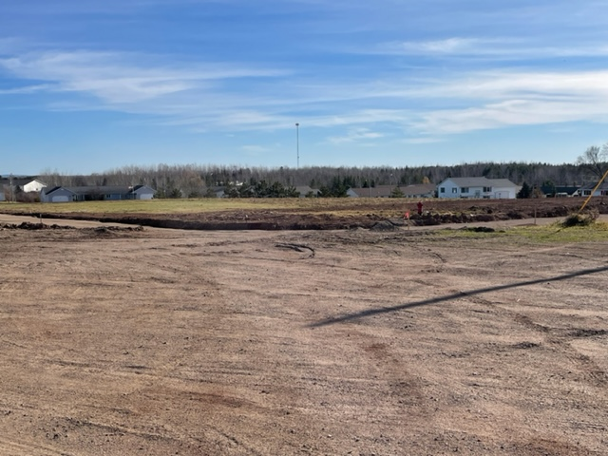
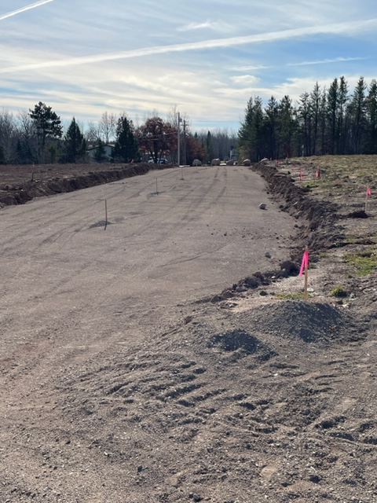
Burnett/Damian 2nd Addition

Slide 5
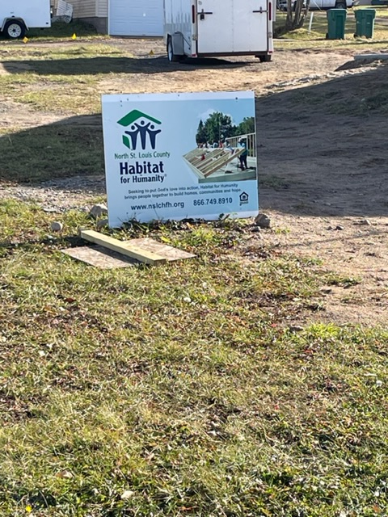
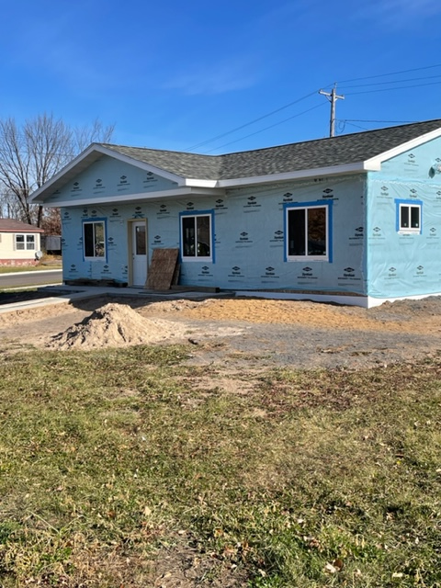
Habitat for Humanity

Slide 6
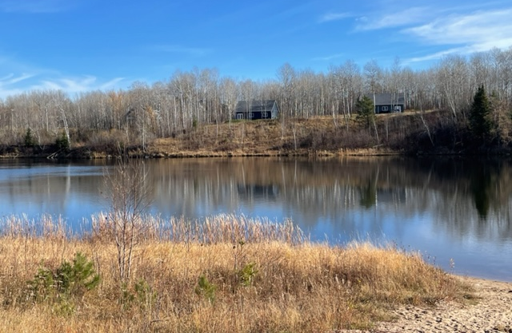
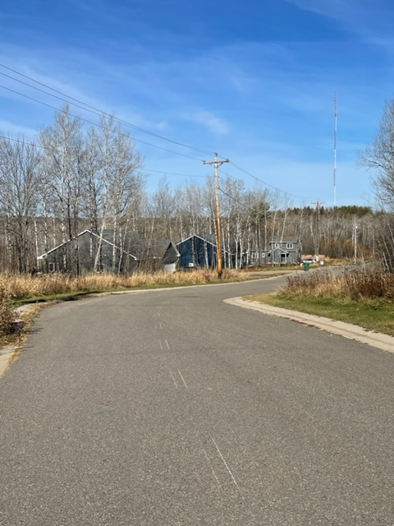
Stubler Development

